Slide 1
Full Stack Development with Java and NoSQL
Nic Raboy | @nraboy

Slide 2
The Agenda
The importance of full-stack development
The different parts of the application stack
Taking control of your data with Couchbase NoSQL
Containers with Docker
Creating a RESTful API
Developing numerous front-end applications
Data synchronization

Slide 3
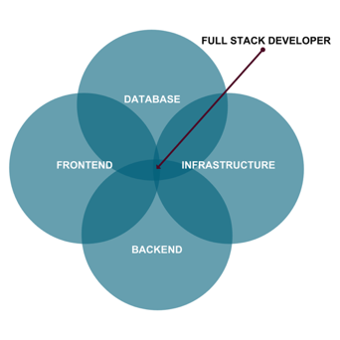
The Role of a Full-Stack Developer

Slide 4
The Breakdown of a Stack
Client Frontend
Desktop
Mobile
IoT
Backend
Web Application
Authentication
Middleware
Database

Slide 5
Our Stack
Client Frontend
JavaFX
Angular
Backend
Web Application
Sync Gateway
Couchbase

Slide 6
Angular
Cross platform applications
Web, Android and iOS (NativeScript & Ionic), Desktop (Electron)
TypeScript
Typed and heavily structured

Slide 7
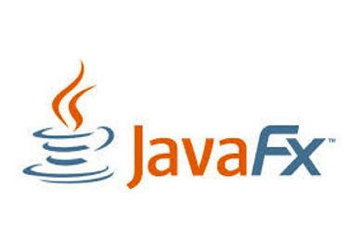
JavaFX
Java desktop applications
Familiar APIs
WYSIWYG UI editor with Scene Builder
Self contained and deployable cross-operating system

Slide 8
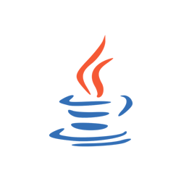
Java Web Application
Do you lift, bro?
Direct interaction with database
Can be accessed from many frontends

Slide 9
NoSQL Database
Easily scalable
Flexible JSON schemas
Less maintenance code
Data format matches API responses

Slide 10
Couchbase: The Complete Database Solution
Couchbase Lite
Sync Gateway
Couchbase Server
EMBEDDED DATABASE
SYNCHRONIZATION
DATABASE SERVER
Lightweight embedded NoSQL database with full CRUD and query functionality.
Secure web gateway with synchronization, REST, stream, batch and event APIs for accessing and synchronizing data over the web.
Highly scalable, highly available, high performance NoSQL database server.
SECURITY
Built-in enterprise level security throughout the entire stack includes user authentication, user and role based data access control (RBAC), secure transport (TLS), and 256-bit AES full database encryption.

Slide 11
Couchbase Lite Overview
Cross-platform support for all major operating systems and platforms
Built native from the ground up
500kb for most platforms
256-bit AES full database encryption
Couchbase Lite
Embedded Database
11

Slide 12
Sync Gateway Overview
Synchronize data between Couchbase Lite and Couchbase Server
REST, Stream, Batch, and Event APIs
Pluggable authentication
Fine grained user and role based access control
Elastically scalable in real-time
Sync Gateway
Synchronization
12

Slide 13
Couchbase Server Overview
Scale easily to thousands of nodes
Consistent high performance that supports millions of concurrent users
Flexible JSON data model
24x365 always-on availability
Couchbase Server
Database Server
13

Slide 14
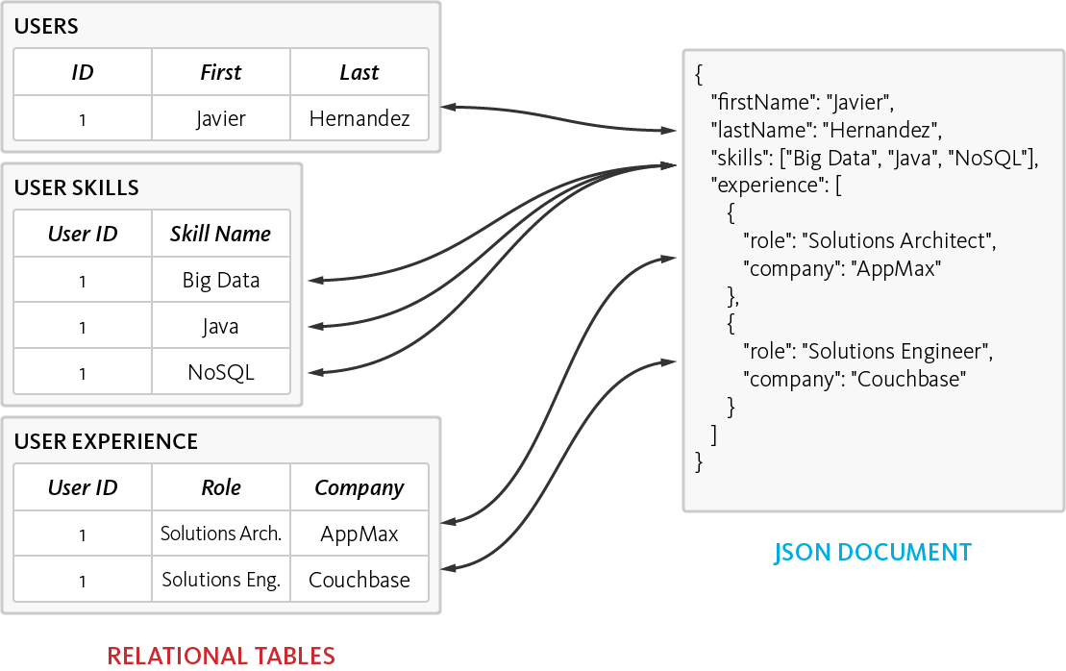
The Power of the Flexible JSON Schema
Ability to store data in multiple ways
De-normalized single document, as opposed to normalizing data across multiple table
Dynamic Schema to add new values when needed

Slide 15
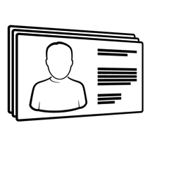
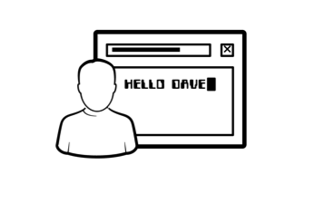
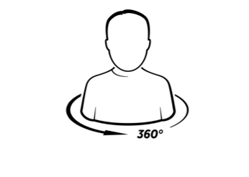
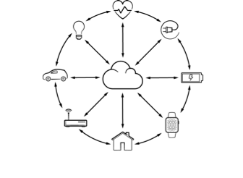
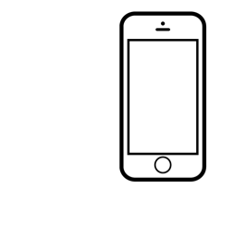
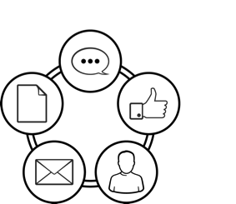
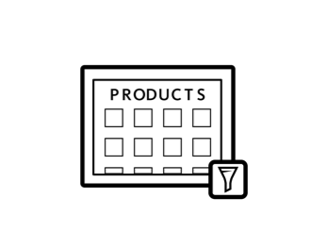
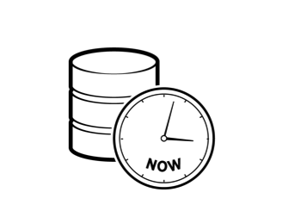
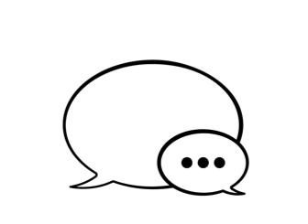
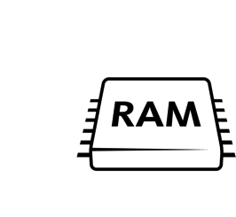
Top Use Cases
Profile Management
Personalization
360º Customer View
Internet of Things
Mobile Applications
Content Management
Catalog
Real Time Big Data
Digital Communication
High Availability Caching

Slide 16
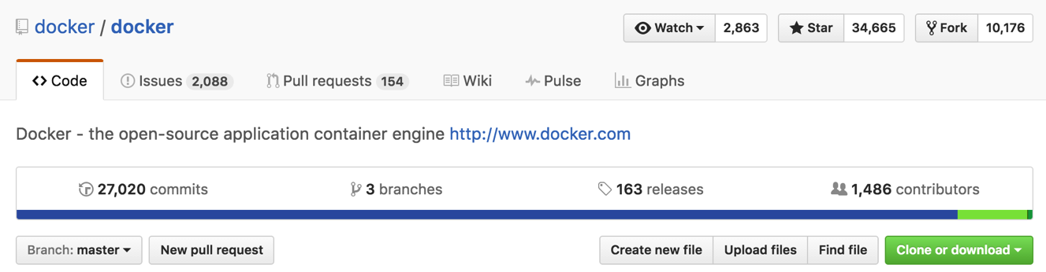
What is Docker?
Open source project and company
Used to create containers for software applications
Package Once Deploy Anywhere (PODA)
Notes:
Docker provides a common packaging format and runtime format that works across operating systems.

Slide 17
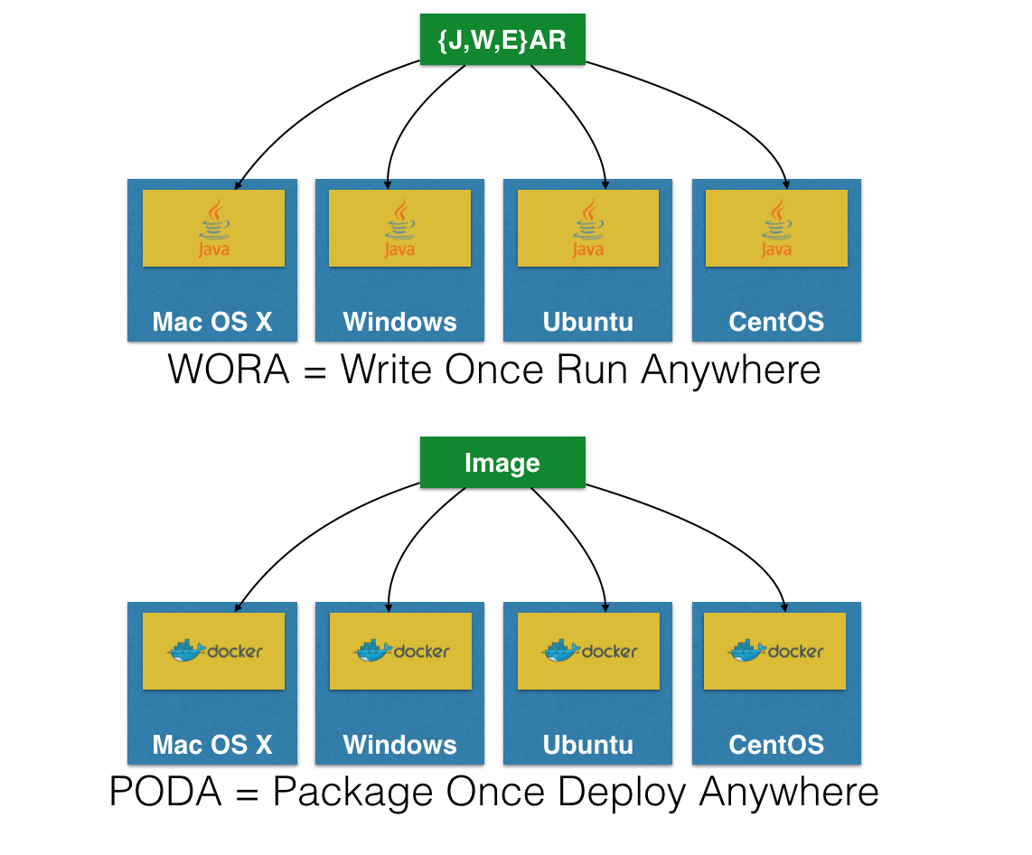
Notes:
Java gave WORA which are archives like JAR files, or other that contain all of the classes of code.
JVM understands the code and the JVM is on various systems.
PODA is a common packaging format called images which are understood by Docker Engine.

Slide 18
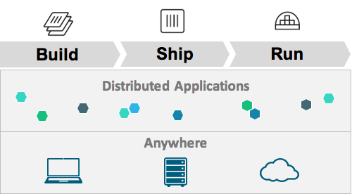
Docker Mission
Notes:
* Docker wants to give tools to build distributed applications, ship them, and run them.

Slide 19
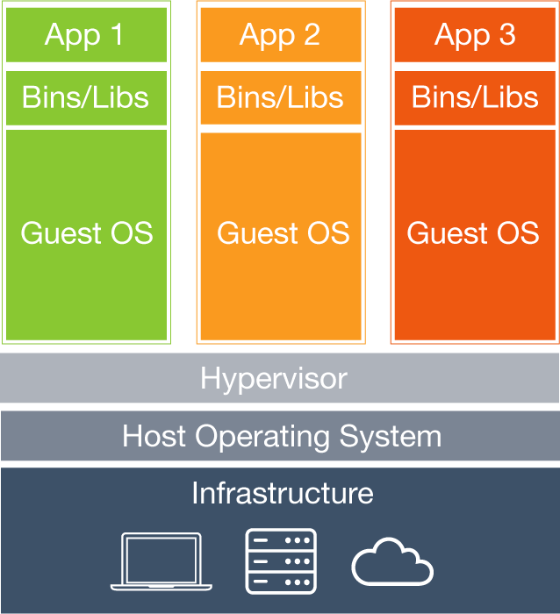
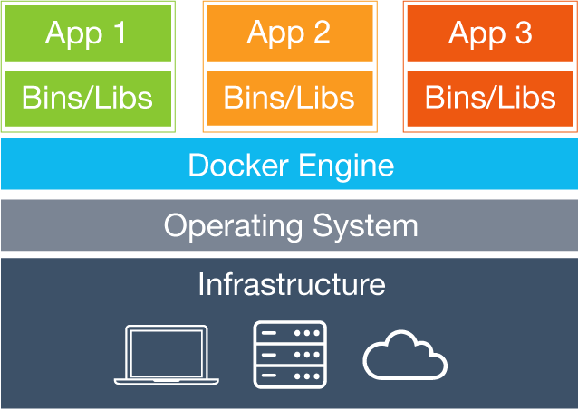
Notes:
Left is the classic VM based model which has a host infrastructure and a hypervisor or VM like VirtualBox
Host infrastructure has to share resources with heavy guest operating systems
Right is the container model which has a host infrastructure and Docker Engine
Minimalist operating systems for each image
The Docker engine as a hypervisor equivalent looks a little bloated. I.e. dockerd merely responds to client requests. It's not really a hypervisor equiv. The container runs on host kernel using kernel LXC not even the host OS. So the Host OS and Docker Engine makes it look more bloated than it is.

Slide 20
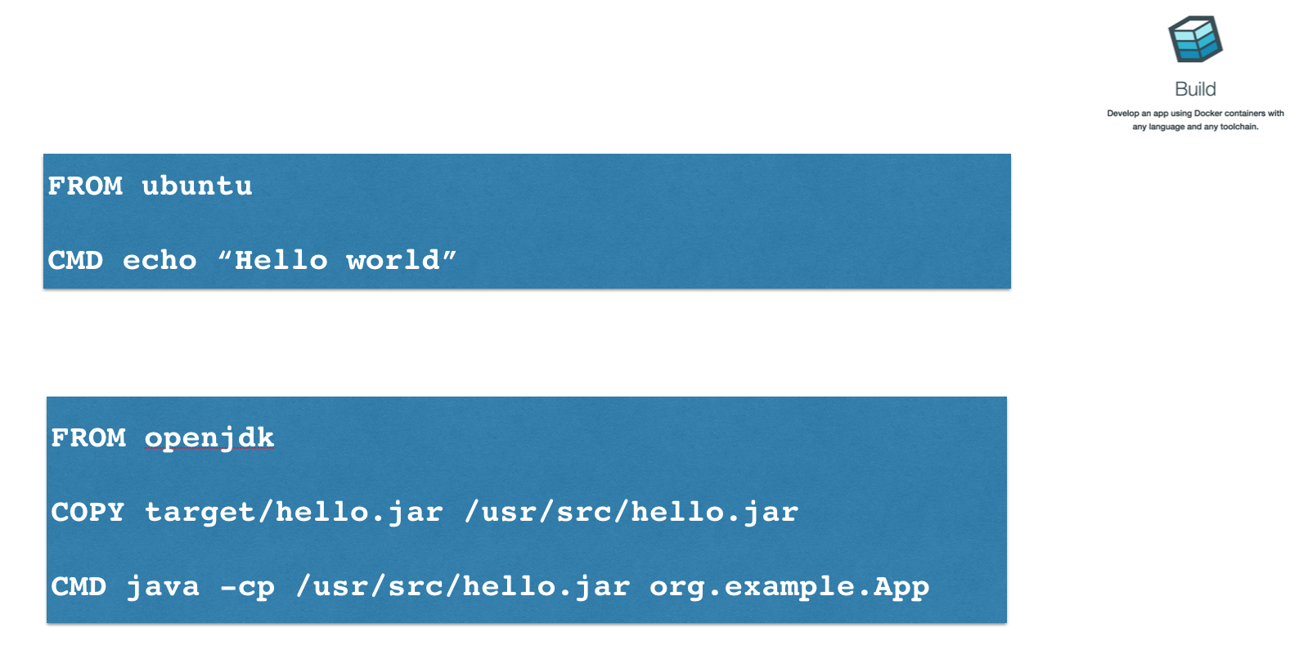
Notes:
Ubuntu has built an Ubuntu based image
Custom base image called openjdk
Each image has a Dockerfile, but only the CMDs in the top most Dockerfile are run

Slide 21
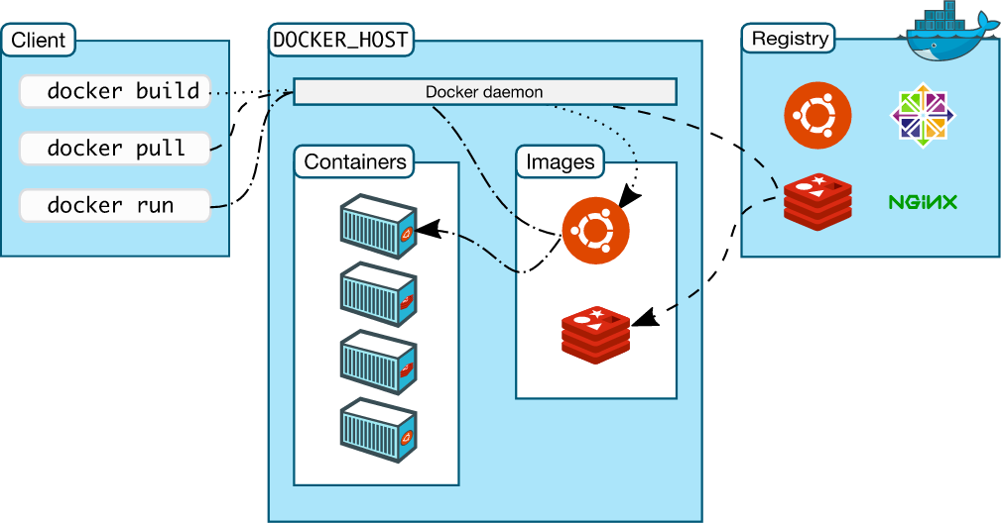


Docker Workflow
Notes:
Client is the Docker CLI
Host is where all the processing happens, where the daemon is running which is Docker Engine
Registry is where images are published

Slide 22

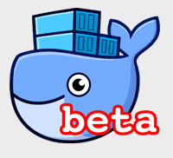
Docker for Mac/Windows
Native application and UI
Auto update capability
No additional software required, e.g. VirtualBox
OSX: xhyve VM using Hypervisor.framework
Windows: Hyper-V VM
Better networking and filesystem mounting/notification
Download: docker.com/getdocker
Requires Yosemite 10.10+ or Windows 10 64-bit
Notes:
Docker for OSX uses Hypervisor.framework which is baked into 10.10+
Docker for Windows uses Hyper-VVM which is baked into Windows
No third party virtual machine software required

Slide 23
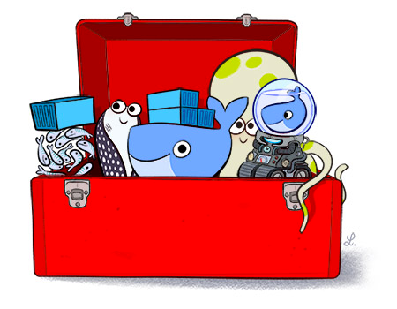
Docker Toolbox
Docker Engine
Docker Machine
Docker Compose
Docker Kitematic
Virtual box
Quickstart Terminal
https://www.docker.com/toolbox
Notes:
* Docker Toolbox is available for people that don’t have access to the latest Windows or macOS

Slide 24
Workshop Goals
Deploy a Couchbase Cluster with Docker
Create a RESTful API with Spring Boot
Consume the RESTful API with Angular
Consume the RESTful API with JavaFX
Add synchronization support to the application

Slide 25
Workshop Material
https://github.com/couchbaselabs/devnexus-java-workshop

Slide 26
Create a Custom Container Deployment

Slide 27
Deploying a Docker Container
docker pull couchbase
docker run -d --name database -p 8091-8094:8091-8094 couchbase
http://localhost:8091

Slide 28
Managing a Docker Container
docker ps
docker logs -f database
docker stop database
docker rm database
docker rmi couchbase

Slide 29
Customizing Docker Images
Custom ‘Dockerfile’
Define base image to be used
FROM couchbase:latest
Copy files from host or execute scripts within the container after deployment
COPY localfile container_file
CMD [“command_to_run”]

Slide 30
Workshop Part #1

Slide 31
Java with Couchbase Server

Slide 32
Connecting to Couchbase

Slide 33
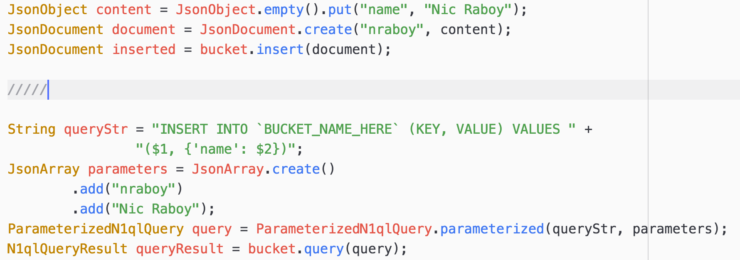
Creating NoSQL Documents

Slide 34
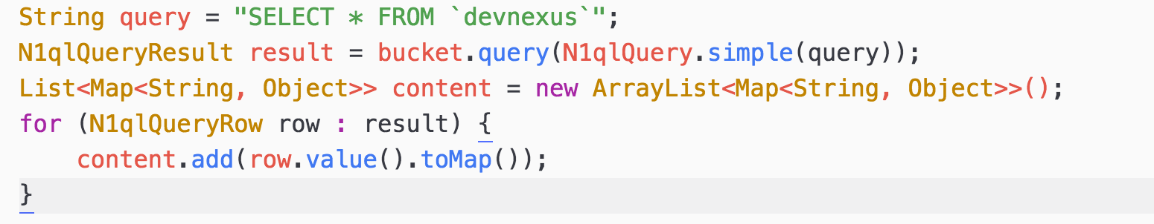
Querying with N1QL

Slide 35
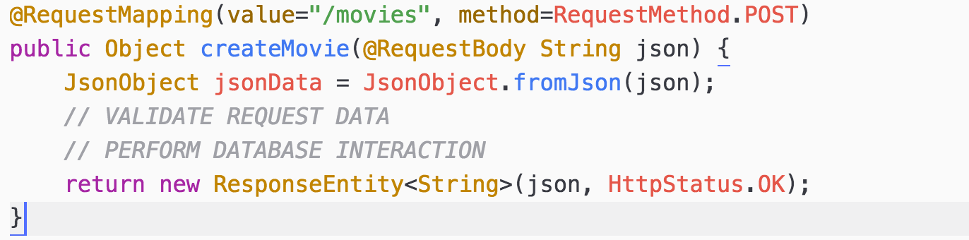
RESTful API Endpoints

Slide 36
API Endpoints
Retrieving all documents
GET /movies
Retrieving documents based on criteria
GET /search?title=
Creating new documents
POST /movies

Slide 37
Workshop Part #2

Slide 38
Building an Angular Front-End

Slide 39
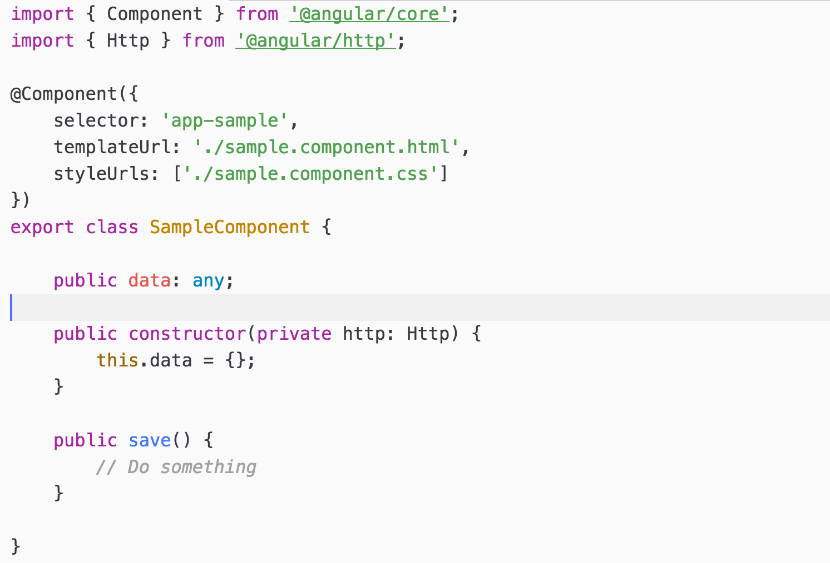
Angular Components

Slide 40
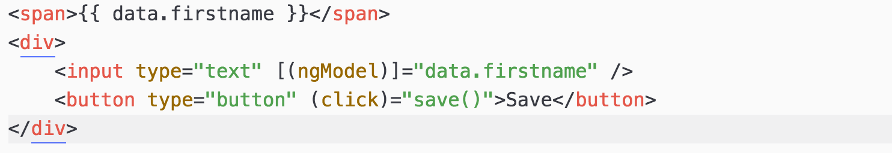
Angular HTML UI

Slide 41
Observables and RxJS
Same APIs as RxJava
Allows for asynchronous interactions
Great for HTTP requests which take variable amounts of time

Slide 42
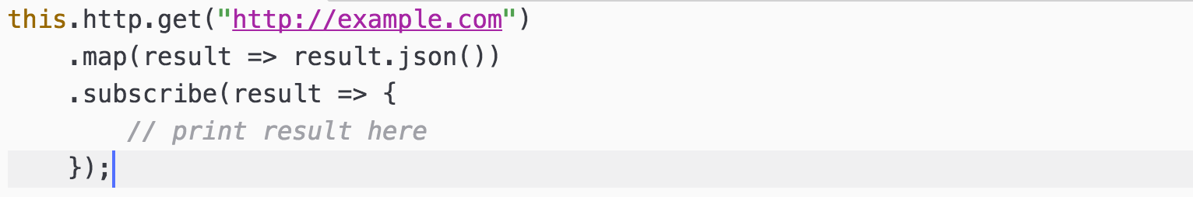
HTTP Requests Against an API

Slide 43
Workshop Part #3

Slide 44
Creating a Desktop Client with JavaFX

Slide 45
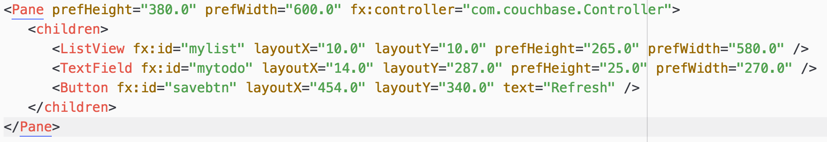
JavaFX Scenes

Slide 46
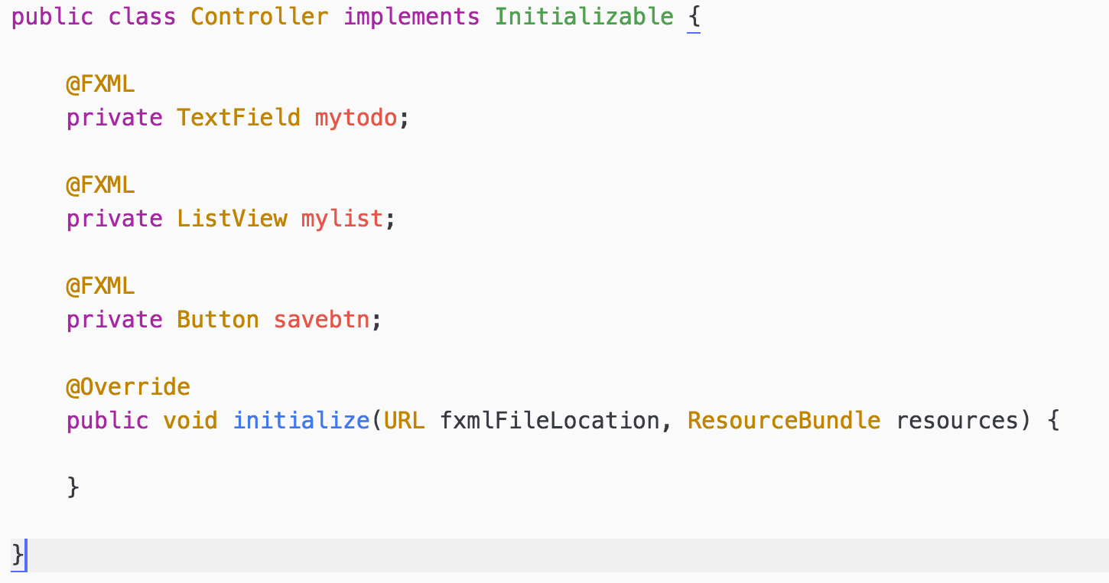
JavaFX Scene Controller

Slide 47
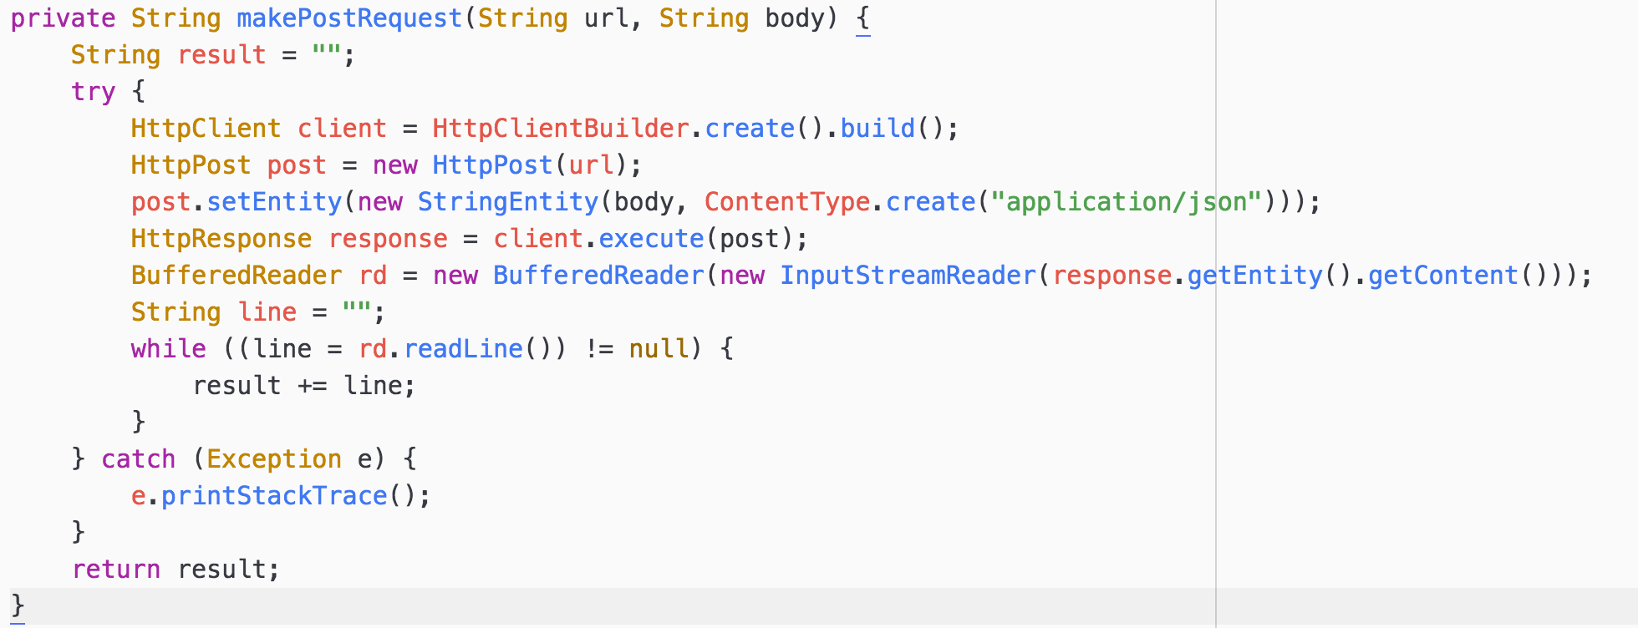
HTTP Requests in Java

Slide 48
Workshop Part #4

Slide 49
Synchronizing Instead of Requesting

Slide 50
Data Differences: Sync vs REST
Local database
Works offline
Two way replication
Data revisions

Slide 51
Local Couchbase Lite Database

Slide 52
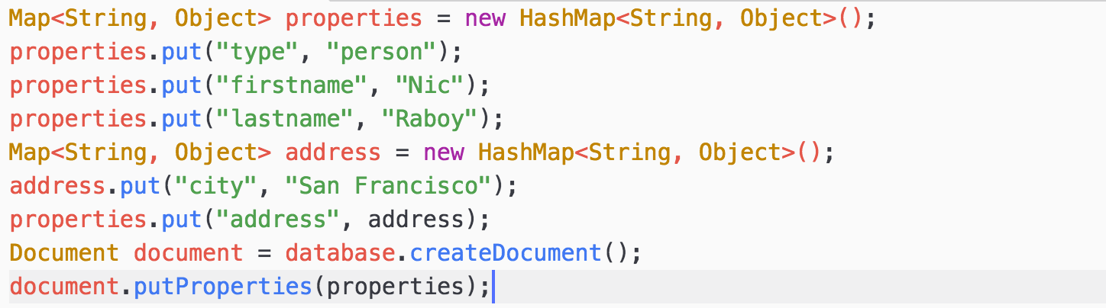
Saving a Document Locally

Slide 53
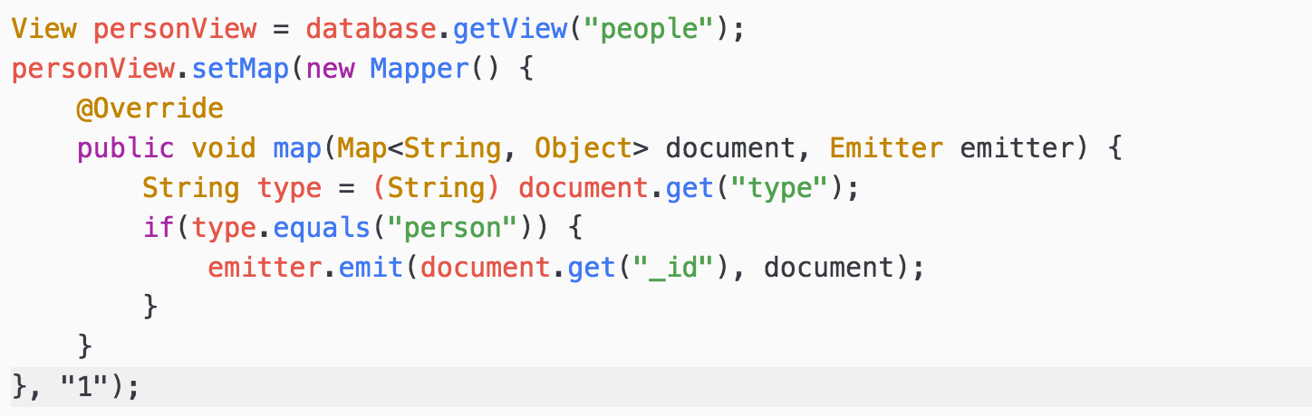
Querying MapReduce Views

Slide 54
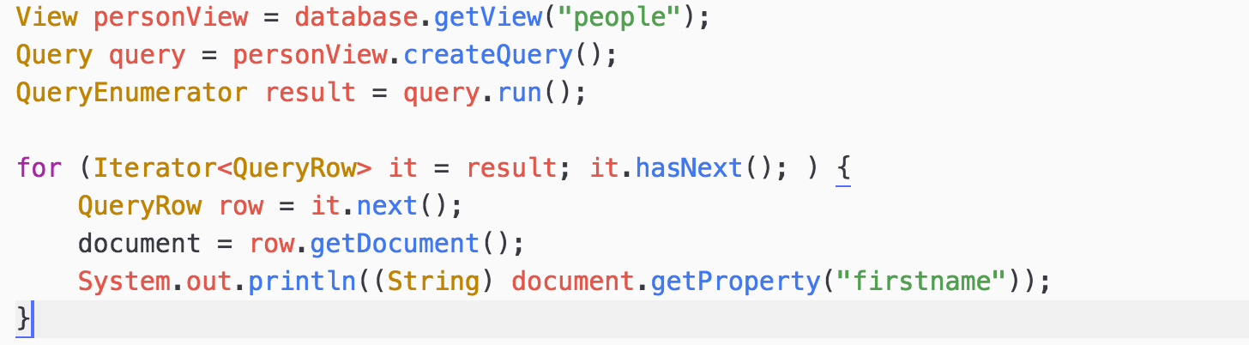
Querying MapReduce Views

Slide 55
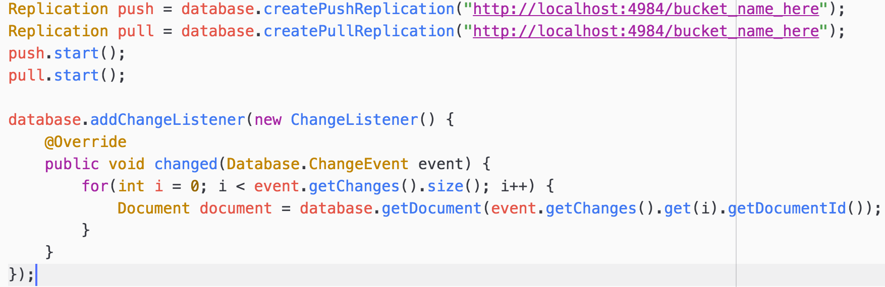
Synchronization and Listeners

Slide 56
Workshop Part #5

Slide 57
Sync and REST in One

Slide 58
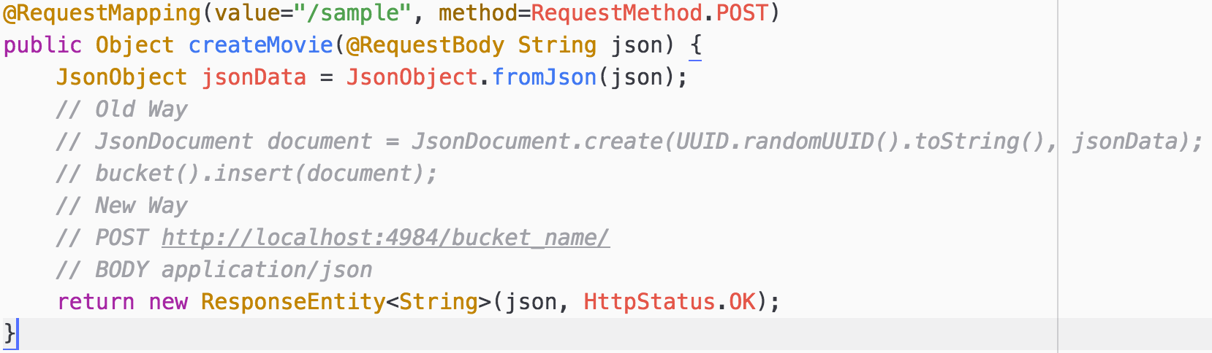
Sync Gateway REST APIs

Slide 59
Workshop Part #6

Slide 60
Project and Sample Applications
https://github.com/couchbaselabs/devnexus-java-workshop
https://github.com/couchbaselabs/try-cb-java
https://github.com/couchbaselabs/comply-java

Slide 61
Where do you find us?
developer.couchbase.com
blog.couchbase.com
@couchbase / @couchbasedev / @nraboy
forums.couchbase.com
stackoverflow.com/questions/tagged/couchbase

